Slide 1
Chapter 12 – Discriminant Analysis
Data Mining for Business Analytics in Python
Shmueli, Bruce, Gedeck & Patel

Slide 2
Discriminant Analysis: Background
A classical statistical technique
Used for classification long before data mining
Classifying organisms into species
Classifying skulls
Fingerprint analysis
And also used for business data mining (loans, customer types, etc.)
Can also be used to highlight aspects that distinguish classes (profiling)
Notes:
‹#›

Slide 3
Import Needed Functionality
import numpy as np
import pandas as pd
from sklearn.discriminant_analysis import
LinearDiscriminantAnalysis
import matplotlib.pylab as plt
from dmba import classificationSummary
Notes:
‹#›

Slide 4
Small Example: Riding Mowers
Goal: classify purchase behavior (buy/no-buy) of riding mowers based on income and lot size
Outcome: owner or non-owner (0/1)
Predictors: lot size, income
Notes:
‹#›

Slide 5
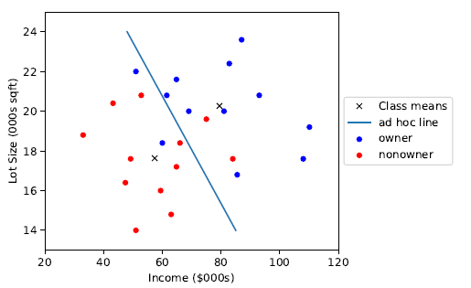
Can we manually draw a line that separates owners from non-owners?
Notes:
‹#›

Slide 6
Example: Loan Acceptance
Consider Universal Bank example with only 2 predictors:
Outcome: consumer accepts loan offer or not
Predictors:
Annual income (Income)
Avg. monthly credit card spending (CCAvg)
Notes:
‹#›

Slide 7
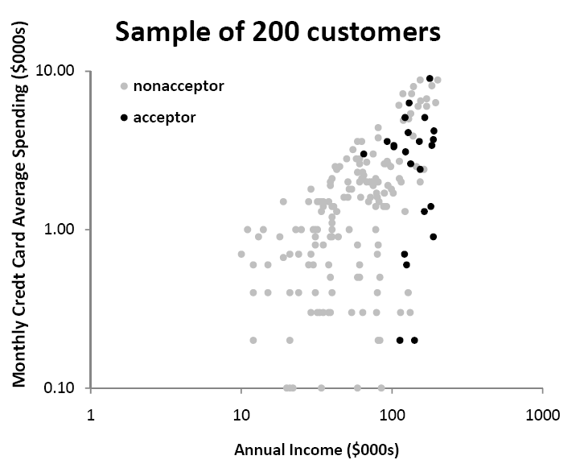
Sample of 200 customers
Notes:
‹#›

Slide 8
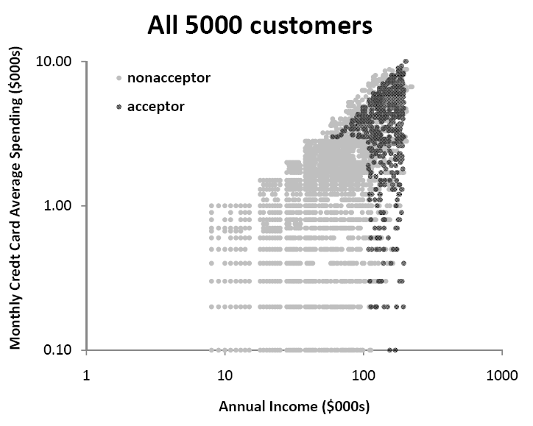
5000 customers
Notes:
‹#›

Slide 9
Algorithm for Discriminant Analysis
Notes:
‹#›

Slide 10
The Idea
To classify a new record, measure its distance from the center of each class
Then, classify the record to the closest class
Notes:
‹#›

Slide 11
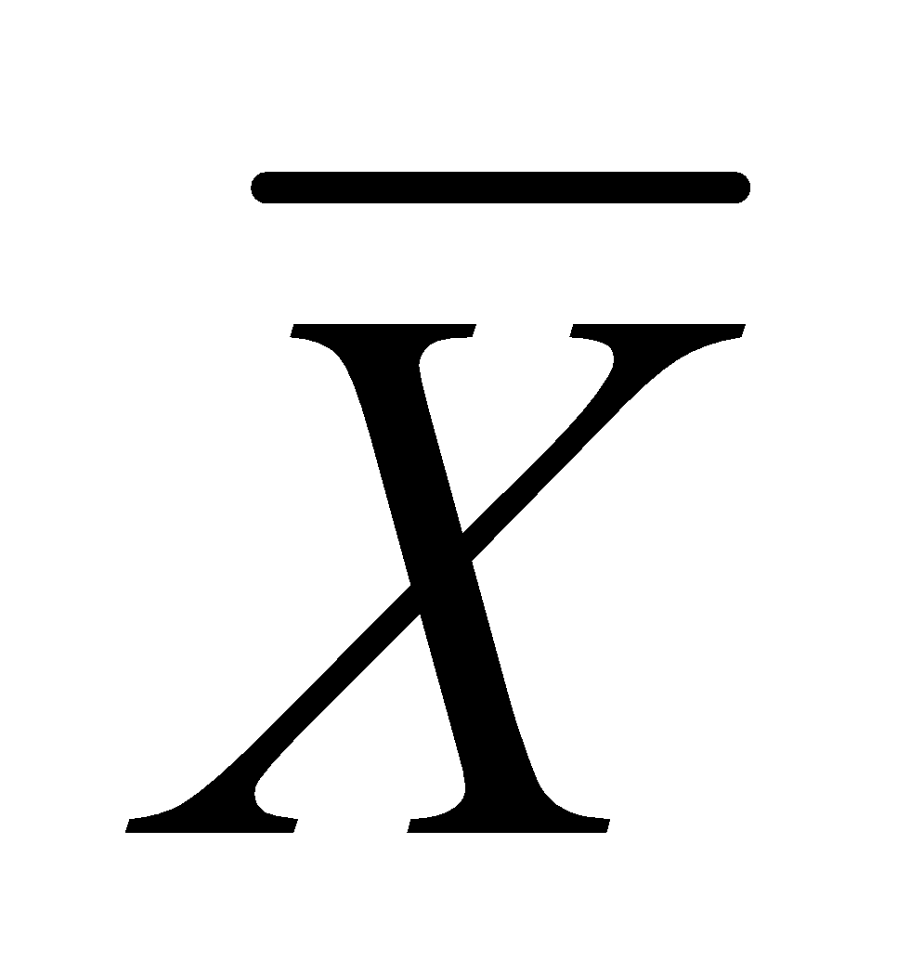
Step 1: Measuring Distance
Need to measure each record’s distance from the center of each class
The center of a class is called a centroid
The centroid is simply a vector (list) of the means of each of the predictors. This mean is computed from all the records that belong to that class.
Notes:
‹#›

Slide 12

Step 1: Measuring Distance – cont.
A popular distance metric is Euclidean Distance (used with KNN). We can use it to measure the distance of a record from a class centroid:
Drawbacks:
Sensitive to scale, variance (can normalize to correct)
Ignores correlation between variables
Notes:
‹#›

Slide 13

Instead, use “Statistical (Mahalanobis) Distance”
transpose (convert column to row)
inverse of covariance matrix S
(p-dimension extension of division)
For a single predictor (p=1), this reduces to a z-score
When p > 1, statistical distance takes account of correlations among predictors (z-score doesn’t)
Notes:
‹#›

Slide 14
Classification & Decision Functions
The idea is to create classification score that reflects the distance from each class
This is done by estimating “classification functions”, which are a function of the statistical distances.
The estimation maximizes the ratio of between-class to within-class variability
Fisher’s linear classification functions: one for each class. Used to compute a classification score.
Classify a record to class with highest score
NOTE: In 2-class case, Python gives decision function (difference between the two classification function) rather than the individual classification functions

Slide 15
Python code
mower_df = pd.read_csv('RidingMowers.csv')
da_reg = LinearDiscriminantAnalysis()
da_reg.fit(mower_df.drop(columns=['Ownership']),
mower_df['Ownership'])
print('Coefficients', da_reg.coef_)
print('Intercept', da_reg.intercept_)
Output
Coefficients [[0.1002303 0.78518471]]
Intercept [-21.73876167]
Decision function: 0.1002(predictor 1) + 0.7852(predictor 2) - 21.7388
If decision function is positive, classify household as class 1, if negative, as class 0

Slide 16

Converting the function scores to propensities (probabilities)
It is possible to convert classification scores (c_{k} being the score for class k) to probabilities of belonging to a class.
P[record i(with measurements x1; x2; :::; xp) belongs to class k] =
The probability is then compared to the cutoff value in order to classify a record

Slide 17
Obtain decision function, predicted classes, probabilities
da_reg = LinearDiscriminantAnalysis()
da_reg.fit(mower_df.drop(columns=['Ownership']),
mower_df['Ownership'])
result_df = mower_df.copy()
result_df['Dec. Function'] =
da_reg.decision_function(mower_df.drop(columns=['Ownership']))
result_df['Prediction'] =
da_reg.predict(mower_df.drop(columns=['Ownership']))
result_df['p(Owner)'] =
a_reg.predict_proba(mower_df.drop(columns=['Ownership']))[:, 1]
result_df
Output (first 3 records)
Income Lot_Size Ownership Dec. Function Prediction p(Owner)
1 60.0 18.4 Owner -1.277545 Nonowner 0.217968
2 85.5 16.8 Owner 0.022032 Owner 0.505508
3 64.8 21.6 Owner 1.716152 Owner 0.847632

Slide 18
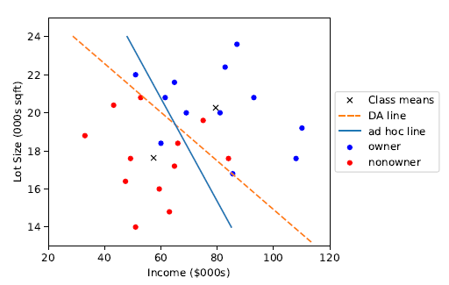
Class separation from discriminant model
Line drawn by eye, earlier

Slide 19
Assumptions & Caveats of Discriminant Analysis
Assumes multivariate normality of predictors
When this condition is met, DA is more efficient than other methods (i.e. needs less data to obtain similar accuracy)
Even when it is not met, DA is robust when we have enough cases in smallest class (> 20) . This means it can be used with dummy variables!
Assumes correlation among predictors within a class is the same across all classes. (Compare correlation tables of each class by eye.)
Sensitive to outliers
Notes:
‹#›

Slide 20
Assessing Predictive Performance
As in other classification methods:
Confusion matrix
Lift
Based on validation data
Notes:
‹#›

Slide 21
Improving Classifications
Notes:
‹#›

Slide 22
Prior Probabilities
If classes are not equally frequent, or their frequency in the sample does not reflect reality, then classification functions can be improved
How?
Incorporate prior (or real) probabilities of class membership:
Add log(p_{j}) to the classification function for class j
P_{j} is probability a case belongs to class j
Notes:
‹#›

Slide 23
Example - Mowers
Sample contains 50% owners, but suppose in population only 15% are owners (i.e. 0.15 probability of being an owner)
Existing classification function constants
Owners: -73.16
Nonowners: -51.42
Adjusted for prior probabilities:
Owners: -73.16 + log(0.15) = -75.06
Nonowners: -51.42 + log(0.85) = -50.58
Notes:
‹#›

Slide 24
Unequal Misclassification Costs
For the two-class (buyer/non-buyer) case, we can account for asymmetric costs of misclassification (C₁, C₂) in same fashion as for unequal prior probabilities
How?
Add log(C₁) and log (C₂) to constants
Often absolute costs are unknown. Instead, use cost ratio:
Set C₁ = 1, C₂ = ratio
Add log (C₂/C₁) to class 2’s constant
Notes:
‹#›

Slide 25
Multiple Classes
Same procedure is used for multiple classes
One classification function for each class
Whichever function has highest value, case is assigned to that class
Notes:
‹#›

Slide 26
Example: Auto Accidents
Outcome: (3 classes)
No injury
Non-fatal injury
Fatal injury
Predictors: Time of day, day of week, weather, type of road, road surface conditions, …
Notes:
‹#›

Slide 27
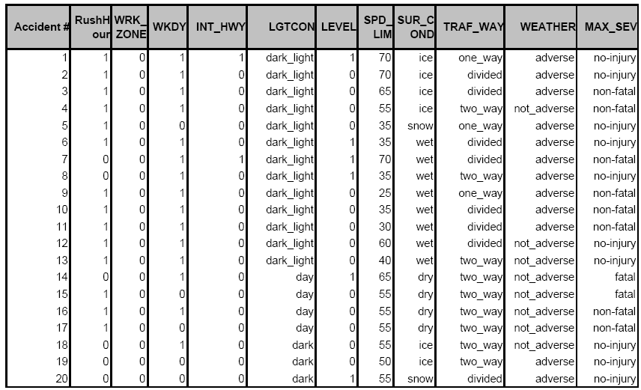
Accident Example: Data Sample
Notes:
‹#›

Slide 28
Code to obtain functions
3-class “Accident” data
accidents_df = pd.read_csv('accidents.csv')
lda_reg = LinearDiscriminantAnalysis()
lda_reg.fit(accidents_df.drop(columns=['MAX_SEV']),
accidents_df['MAX_SEV'])
print('Coefficients and intercept')
fct = pd.DataFrame([lda_reg.intercept_], columns=lda_reg.classes_,
index=['constant'])
fct = fct.append(pd.DataFrame(lda_reg.coef_.transpose(),
columns=lda_reg.classes_, index=list(accidents_df.columns)[:-1]))
print(fct)
Notes:
‹#›

Slide 29
Output
Coefficients and intercept (constant)
fatal no-injury non-fatal
constant -1.972659 -0.891172 -0.610471
RushHour -0.996411 0.033430 -0.015774
WRK_ZONE -0.457188 0.220012 -0.204480
WKDY -1.471777 0.165707 -0.135404
INT_HWY 0.755344 -0.075816 0.060599
LGTCON_day 0.009515 -0.031421 0.030124
LEVEL 0.976626 -0.082717 0.063598
SPD_LIM 0.048033 0.004381 -0.005014
SUR_COND_dry -5.999809 -0.164874 0.257895
TRAF_two_way 0.752985 -0.012844 -0.000048
WEATHER_adverse -6.596690 0.079166 0.032564
From these values, get 3 classification functions - one for each outcome (column)
Notes:
‹#›

Slide 30
Classification scores, classifications, propensities
result = pd.concat([
pd.DataFrame({'Classification':
lda_reg.predict(accidents_df.drop(columns=['MAX_SEV'])),
'Actual': accidents_df['MAX_SEV']}),
pd.DataFrame(lda_reg.decision_function(accidents_df.drop(
columns=['MAX_SEV'])), columns=['Score {}'.format(cls) for cls
in lda_reg.classes_]),
pd.DataFrame(lda_reg.predict_proba(accidents_df.drop
(columns=['MAX_SEV'])), columns=['Propensity {}'.format(cls)
for cls in lda_reg.classes_])
], axis=1)
output next slide

Slide 31

Output
-0.46 is highest classification score so classification is “no-injury”
print(result.head())
Classification Actual Score fatal Score no-injury Score non-fatal \
0 no-injury no-injury -5.94 -0.46 -0.96
1 no-injury non-fatal -1.05 -0.46 -1.04
2 no-injury no-injury -7.88 -0.63 -0.77
3 no-injury no-injury -8.38 -0.54 -0.84
4 no-injury non-fatal -9.84 -0.50 -0.85
Propensity fatal Propensity no-injury Propensity non-fatal
0 0.00e+00 0.58 0.42
1 2.86e-01 0.43 0.29
2 0.00e+00 0.52 0.48
3 0.00e+00 0.55 0.45
4 0.00e+00 0.56 0.44

Slide 32
Summary
Discriminant analysis is based on measuring the distance of a record from the class centers
The distance metric used is statistical distance, which takes into account the correlations between predictors
Assumptions: equal correlations within each class, and normality (but fairly robust to violation of normality)
Sensitive to outliers (explore the data!)
Classification functions useful for profiling: can order predictors in terms of separating the classes

